Slide 1
12장. 계층 쿼리 (Hierarchical Query)
[ 이번 장에서 배울 내용들]
1. 계층형 쿼리의 의미와 원리를 배웁니다.
2. 계층형 쿼리를 작성하는 방법을 배웁니다.

Slide 2
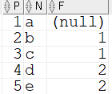
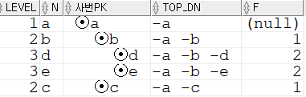
계층쿼리(요약1)
P
F
DROP TABLE TB CASCADE CONSTRAINTS ;
purge recyclebin;
CREATE TABLE TB
(P NUMBER
,N CHAR(2)
,F NUMBER
);
insert into TB values (1, 'a','');
insert into TB values (2, 'b', 1);
insert into TB values (3, 'c', 1);
insert into TB values (4, 'd', 2);
insert into TB values (5, 'e', 2);
commit;
select * from TB;
1
a
-
TB
P | N | F
1 | a | -
2 | b | 1
3 | c | 1
4 | d | 2
5 | e | 2
P
F
P
F
2
b
1
3
c
1
P
F
P
F
4
d
2
5
e
2
P
F
4
d
2
P
F
pk : fk
P
F
2
b
1
P
F
1
5
e
2
P
F
1
a
-
2
1
3
c
1
4
2
start with F is null connect by prior P = F;
start with F is null connect by P = prior F;
5
2
3
1
select LEVEL, N
,LPAD('⊙',2*LEVEL)||N 사번pk
,sys_connect_by_path(N,'-') top_dn
,F
from TB where 1<2
start with F is null --P=1
connect by prior P = F;
select LEVEL, 이름
,LPAD('⊙',4*LEVEL)||사번 사번pk
,상관
from 사원
start with 사번= 5
connect by 사번= prior 상관;
prior 사번(pk) = 상관(fk)
사번(pk) = prior 상관(fk)
1
LEVEL 이름 사번PK 상관
------ ------ --------------- -----
1 E ⊙5 3
2 C ⊙3 1
3 A ⊙1
1
2
1
2
1
3
1
3
1
4
3
4
3
5
3
5
3

Slide 3
계층쿼리(요약2)
사원
사번(pk) | 이름 | 상관(fk)
1 | A | -
2 | B | 1
3 | C | 1
4 | D | 3
5 | E | 3
사번(pk)1: N상관(fk)
1
2
1
3
1
4
3
5
3
select LEVEL, 이름
,LPAD('⊙', 4*LEVEL) || 사번 사번pk
,상관
from 사원
start with 상관= 3
connect by 사번= prior 상관;
select LEVEL, 이름
,LPAD('⊙'||사번, 4*LEVEL) 사번pk
,상관
from 사원
start with 상관=1
connect by prior 사번=상관;
LEVEL 이름 사번PK 상관
------ ------ --------------- -----
1 B ⊙2 1
1 C ⊙3 1
2 D ⊙4 3
2 E ⊙5 3
prior 사번(pk) = 상관(fk)
사번(pk) = prior 상관(fk)
1
LEVEL 이름 사번PK 상관
------ ------ --------------- -----
1 D ⊙4 3
2 C ⊙3 1
3 A ⊙1
1 E ⊙5 3
2 C ⊙3 1
3 A ⊙1
2
1
1
3
1
2
1
4
3
3
1
5
3
4
3
5
3

Slide 4
계층쿼리(요약3)
사번(pk)1: N상관(fk)
사원
사번(pk) | 이름 | 상관(fk)
1 | A | -
2 | B | 1
3 | C | 1
4 | D | 3
5 | E | 3
A
1
B
2
1
C
3
1
D
4
3
E
5
3
select LEVEL, prior 이름, 이름, prior 사번
,LPAD('⊙', 4*LEVEL) || 사번 사원no
,prior 상관, 상관
from 사원
start with 상관= 3
connect by 사번= prior 상관;
col 사원no for a15
col prior이름 for a9
select LEVEL, prior 이름, 이름, prior 사번
,LPAD('⊙'||사번, 4*LEVEL) 사원no
,prior 상관, 상관
from 사원
start with 사번=1
connect by prior 사번=상관;
prior 사번(pk) = 상관(fk)
A
1
사번(pk) = prior 상관(fk)
B
2
1
A
1
C
3
1
B
2
1
D
4
3
C
3
1
E
5
3
D
4
3
E
5
3
LEVEL PRIOR이름 이름 PRIOR사번 사원NO PRIOR상관 상관
----- --------- ------ ---------- --------------- ---------- ----
1 D ⊙4 3
2 D C 4 ⊙3 3 1
3 C A 3 ⊙1 1
1 E ⊙5 3
2 E C 5 ⊙3 3 1
3 C A 3 ⊙1 1
LEVEL PRIOR이름 이름 PRIOR사번 사원NO PRIOR상관 상관
----- --------- ------ ---------- --------------- ---------- ----
1 A ⊙1
2 A B 1 ⊙2 1
2 A C 1 ⊙3 1
3 C D 3 ⊙4 1 3
3 C E 3 ⊙5 1 3

Slide 5
계층쿼리(요약4)
계층쿼리 사용 후
col ename for a6
col 사번pk for a20
col empno for 9999
col mgr for 9999
SELECT ename,LPAD(' ',(LEVEL-1)*4)||'*'||empno 사번pk, mgr
FROM emp
START WITH empno = 7839
CONNECT BY PRIOR empno = mgr;
계층쿼리 사용 전
select ename, empno, mgr from emp;
ENAME EMPNO MGR
------ ----- -----
SMITH 7369 7902
ALLEN 7499 7698
WARD 7521 7698
JONES 7566 7839
MARTIN 7654 7698
BLAKE 7698 7839
CLARK 7782 7839
SCOTT 7788 7566
KING 7839
TURNER 7844 7698
ADAMS 7876 7788
JAMES 7900 7698
FORD 7902 7566
MILLER 7934 7782
14 개의 행이 선택되었습니다.
ENAME 사번PK MGR
------ -------------------- -----
KING *7839
JONES *7566 7839
SCOTT *7788 7566
ADAMS *7876 7788
FORD *7902 7566
SMITH *7369 7902
BLAKE *7698 7839
ALLEN *7499 7698
WARD *7521 7698
MARTIN *7654 7698
TURNER *7844 7698
JAMES *7900 7698
CLARK *7782 7839
MILLER *7934 7782
14 개의 행이 선택되었습니다.

Slide 6
1. 계층형 쿼리의 문법
col ename for a25
SELECT LPAD(ename,LEVEL*4,'*') "ENAME"
, empno, mgr
FROM emp
CONNECT BY PRIOR empno = mgr
START WITH empno = 7839 ;
col ename for a25
SELECT LPAD(ename,LEVEL*4,'*') "ENAME"
, empno, mgr
FROM emp
CONNECT BY empno = PRIOR mgr
START WITH empno = 7839 ;
ENAME EMPNO MGR
------------------------- ----- -----
KING 7839
***JONES 7566 7839
*******SCOTT 7788 7566
***********ADAMS 7876 7788
********FORD 7902 7566
***********SMITH 7369 7902
***BLAKE 7698 7839
*******ALLEN 7499 7698
********WARD 7521 7698
******MARTIN 7654 7698
******TURNER 7844 7698
*******JAMES 7900 7698
***CLARK 7782 7839
******MILLER 7934 7782
14 개의 행이 선택되었습니다.
ENAME EMPNO MGR
------------------------- ----- -----
KING 7839
top down<-
N : 1
자:부
-> bottom up
mgr
empno

Slide 7
‘SMITH’ 사원의 상사들을 출력하기
col ename for a25
SELECT LPAD('◎',LEVEL*4)||ename "ENAME"
, empno, mgr
FROM emp
CONNECT BY PRIOR empno = mgr
START WITH empno = 7839 ;
SELECT LPAD(ename, LEVEL*5, '.') ENAME
FROM emp
CONNECT BY empno= PRIOR mgr
START WITH empno=7369 ;
ENAME EMPNO MGR
------------------------- ----- -----
◎KING 7839
◎JONES 7566 7839
◎SCOTT 7788 7566
◎ADAMS 7876 7788
◎FORD 7902 7566
◎SMITH 7369 7902
◎BLAKE 7698 7839
◎ALLEN 7499 7698
◎WARD 7521 7698
◎MARTIN 7654 7698
◎TURNER 7844 7698
◎JAMES 7900 7698
◎CLARK 7782 7839
◎MILLER 7934 7782
14 개의 행이 선택되었습니다.
ENAME
-------------------------
SMITH
......FORD
..........JONES
................KING

Slide 8
계층형 쿼리의 실행 순서
1. START WITH 절에 시작조건을 찾습니다
2. CONNECT BY 절에 연결 조건을 찾습니다
3. WHERE 절의 조건을 검색합니다
* 계층형 쿼리를 작성 시 몇 가지 주의 사항
1. CONNECT BY 절에는 Sub Query 를 사용할 수 없습니다.
2. 대량데이터가 있을 경우에 시간이 오래 걸릴 수 있으므로 START WITH 절과
CONNECT BY 절, WHERE 절의 컬럼에는 반드시 인덱스가 적절하게 설정되어 있어야 합니다.
3.부분범위 처리 기법을 아쉽게도 계층형 쿼리에서는 사용할 수 없습니다.

Slide 9
2. 계층형 쿼리의 기본 구조
− START WITH mgr IS NULL : 계층구조 시작 조건
− CONNECT BY PRIOR empno = mgr : 계층구조 전개 조건
− ORDER SIBLINGS BY : 같은 LEVEL행들의 정렬 컬럼
SELECT empno, ename, job, mgr, PRIOR ename as mgr_name
, LEVEL ,LPAD(' ', (LEVEL-1)*2, '.')||ENAME depth_ename
,SYS_CONNECT_BY_PATH(ename,'-') ename_list
FROM emp
START WITH mgr is NULL
CONNECT BY PRIOR empno = mgr
ORDER SIBLINGS BY empno;
-자신을 관리하는 상사의 사번은 mgr.
EMPNO ENAME JOB MGR MGR_NAME LEVEL DEPTH_ENAME ENAME_LIST
----- ------ ---------- ----- -------- ----- ------------- -------------------------
7839 KING PRESIDENT 1 KING -KING
7566 JONES MANAGER 7839 KING 2 . JONES -KING-JONES
7788 SCOTT ANALYST 7566 JONES 3 ... SCOTT -KING-JONES-SCOTT
7876 ADAMS CLERK 7788 SCOTT 4 ..... ADAMS -KING-JONES-SCOTT-ADAMS
7902 FORD ANALYST 7566 JONES 3 ... FORD -KING-JONES-FORD
7369 SMITH CLERK 7902 FORD 4 ..... SMITH -KING-JONES-FORD-SMITH
7698 BLAKE MANAGER 7839 KING 2 . BLAKE -KING-BLAKE
7499 ALLEN SALESMAN 7698 BLAKE 3 ... ALLEN -KING-BLAKE-ALLEN
7521 WARD SALESMAN 7698 BLAKE 3 ... WARD -KING-BLAKE-WARD
7654 MARTIN SALESMAN 7698 BLAKE 3 ... MARTIN -KING-BLAKE-MARTIN
7844 TURNER SALESMAN 7698 BLAKE 3 ... TURNER -KING-BLAKE-TURNER
7900 JAMES CLERK 7698 BLAKE 3 ... JAMES -KING-BLAKE-JAMES
7782 CLARK MANAGER 7839 KING 2 . CLARK -KING-CLARK
7934 MILLER CLERK 7782 CLARK 3 ... MILLER -KING-CLARK-MILLER
col depth_ename for a13
col ename_list for a25
col ename for a6
col job for a10
col mgr for 9999
col mgr_name for a8
col level for 9999

Slide 10
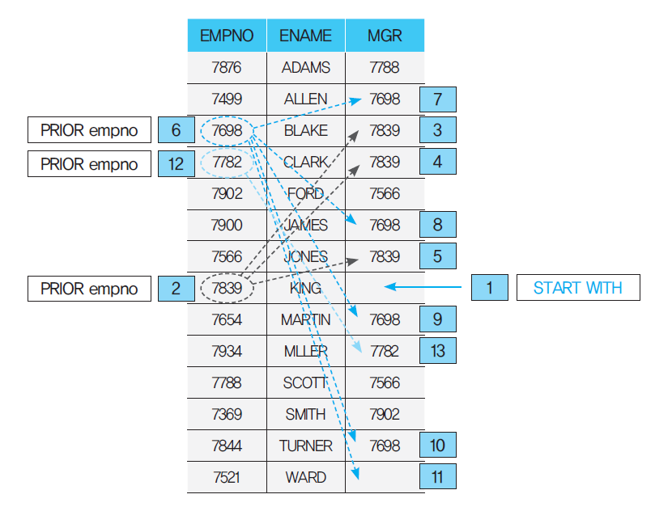
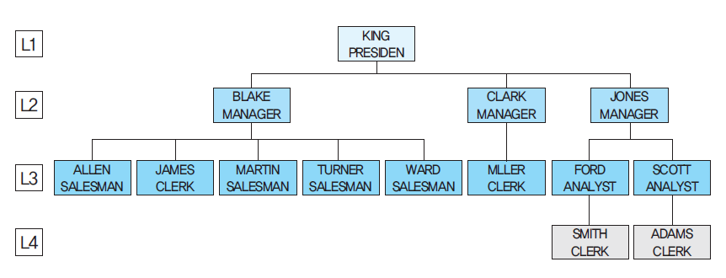
2. 계층형 쿼리 기본 구조
ENAME EMPNO MGR
------------------------- ----- -----
◎KING 7839
◎JONES 7566 7839
◎SCOTT 7788 7566
◎ADAMS 7876 7788
◎FORD 7902 7566
◎SMITH 7369 7902
◎BLAKE 7698 7839
◎ALLEN 7499 7698
◎WARD 7521 7698
◎MARTIN 7654 7698
◎TURNER 7844 7698
◎JAMES 7900 7698
◎CLARK 7782 7839
◎MILLER 7934 7782
14 개의 행이 선택되었습니다.

Slide 11
3. 계층 구조에서 일부분만 계층화하기
ENAME EMPNO MGR
------------------------- ----- -----
◎KING 7839
◎JONES 7566 7839
◎SCOTT 7788 7566
◎ADAMS 7876 7788
◎FORD 7902 7566
◎SMITH 7369 7902
◎BLAKE 7698 7839
◎ALLEN 7499 7698
◎WARD 7521 7698
◎MARTIN 7654 7698
◎TURNER 7844 7698
◎JAMES 7900 7698
◎CLARK 7782 7839
◎MILLER 7934 7782
14 개의 행이 선택되었습니다.
col depthEname for a20
col empnoList for a20
col job for a10
SELECT empno, job, mgr, LEVEL
,LPAD(' ', (LEVEL-1)*4,' ')||ename "depthENAME"
,SYS_CONNECT_BY_PATH(ename,'-') empnoList
FROM emp
START WITH mgr is NULL
CONNECT BY PRIOR empno = mgr AND ename <> 'JONES'
ORDER SIBLINGS BY ename;
EMPNO JOB MGR LEVEL depthENAME EMPNOLIST
---------- ---------- ---------- ---------- -------------------- --------------------
7839 PRESIDENT 1 KING -KING
7698 MANAGER 7839 2 BLAKE -KING-BLAKE
7499 SALESMAN 7698 3 ALLEN -KING-BLAKE-ALLEN
7900 CLERK 7698 3 JAMES -KING-BLAKE-JAMES
7654 SALESMAN 7698 3 MARTIN -KING-BLAKE-MARTIN
7844 SALESMAN 7698 3 TURNER -KING-BLAKE-TURNER
7521 SALESMAN 7698 3 WARD -KING-BLAKE-WARD
7782 MANAGER 7839 2 CLARK -KING-CLARK
7934 CLERK 7782 3 MILLER -KING-CLARK-MILLER
9 개의 행이 선택되었습니다.

Slide 12
3. 계층 구조에서 일부분만 계층화하기
ENAME EMPNO MGR
------------------------- ----- -----
◎KING 7839
◎JONES 7566 7839
◎SCOTT 7788 7566
◎ADAMS 7876 7788
◎FORD 7902 7566
◎SMITH 7369 7902
◎BLAKE 7698 7839
◎ALLEN 7499 7698
◎WARD 7521 7698
◎MARTIN 7654 7698
◎TURNER 7844 7698
◎JAMES 7900 7698
◎CLARK 7782 7839
◎MILLER 7934 7782
14 개의 행이 선택되었습니다.
col depthEname for a20
col empnoList for a25
col job for a10
SELECT empno, job, mgr, LEVEL
,LPAD(' ', (LEVEL-1)*2,' ')||ename "depthENAME"
,SYS_CONNECT_BY_PATH(ename,'-') empnoList
FROM emp
WHERE ename <> 'JONES'
START WITH mgr is NULL
CONNECT BY PRIOR empno = mgr
ORDER SIBLINGS BY ename;
EMPNO JOB MGR LEVEL depthENAME EMPNOLIST
---------- ---------- ----- ----- -------------------- -------------------------
7839 PRESIDENT 1 KING -KING
7698 MANAGER 7839 2 BLAKE -KING-BLAKE
7499 SALESMAN 7698 3 ALLEN -KING-BLAKE-ALLEN
7900 CLERK 7698 3 JAMES -KING-BLAKE-JAMES
7654 SALESMAN 7698 3 MARTIN -KING-BLAKE-MARTIN
7844 SALESMAN 7698 3 TURNER -KING-BLAKE-TURNER
7521 SALESMAN 7698 3 WARD -KING-BLAKE-WARD
7782 MANAGER 7839 2 CLARK -KING-CLARK
7934 CLERK 7782 3 MILLER -KING-CLARK-MILLER
7902 ANALYST 7566 3 FORD -KING-JONES-FORD
7369 CLERK 7902 4 SMITH -KING-JONES-FORD-SMITH
7788 ANALYST 7566 3 SCOTT -KING-JONES-SCOTT
7876 CLERK 7788 4 ADAMS -KING-JONES-SCOTT-ADAMS
13 개의 행이 선택되었습니다.

Slide 13
4. CONNECT_BY_ISLEAF ( ) 함수
ENAME EMPNO MGR
------------------------- ----- -----
◎KING 7839
◎JONES 7566 7839
◎SCOTT 7788 7566
◎ADAMS 7876 7788
◎FORD 7902 7566
◎SMITH 7369 7902
◎BLAKE 7698 7839
◎ALLEN 7499 7698
◎WARD 7521 7698
◎MARTIN 7654 7698
◎TURNER 7844 7698
◎JAMES 7900 7698
◎CLARK 7782 7839
◎MILLER 7934 7782
14 개의 행이 선택되었습니다.
Test 1 ) CONNECT_BY_ISLEAF( ) 함수를 사용 안하고 출력하기
col "low->high" for a26
col ename for a30
SELECT CONNECT_BY_ISLEAF
, LPAD(ename, LEVEL*5, '*') ENAME
,SYS_CONNECT_BY_PATH(ename,'->') "low->high"
FROM emp
START WITH empno=7369
CONNECT BY empno= PRIOR mgr;
CONNECT_BY_ISLEAF ENAME low->high
----------------- ------------------------------ --------------------------
0 SMITH ->SMITH
0 ******FORD ->SMITH->FORD
0 **********JONES ->SMITH->FORD->JONES
1 ****************KING ->SMITH->FORD->JONES->KING
중간노드
잎 노드

Slide 14
Test 2) CONNECT_BY_ISLEAF 함수의 값을 0 으로 설정해서 마지막 값을 삭제하기
ENAME EMPNO MGR
------------------------- ----- -----
◎KING 7839
◎JONES 7566 7839
◎SCOTT 7788 7566
◎ADAMS 7876 7788
◎FORD 7902 7566
◎SMITH 7369 7902
◎BLAKE 7698 7839
◎ALLEN 7499 7698
◎WARD 7521 7698
◎MARTIN 7654 7698
◎TURNER 7844 7698
◎JAMES 7900 7698
◎CLARK 7782 7839
◎MILLER 7934 7782
14 개의 행이 선택되었습니다.
SELECT CONNECT_BY_ISLEAF
, LPAD(ename, LEVEL*5, '*') ENAME
,SYS_CONNECT_BY_PATH(ename,'->') "low->high"
FROM emp
WHERE CONNECT_BY_ISLEAF =0
START WITH empno=7369
CONNECT BY empno= PRIOR mgr;
CONNECT_BY_ISLEAF ENAME low->high
----------------- ------------------------------ --------------------------
0 SMITH ->SMITH
0 ******FORD ->SMITH->FORD
0 **********JONES ->SMITH->FORD->JONES
중간노드

Slide 15
Test 3) CONNECT_BY_ISLEAF 함수의 값을 1 로 설정해서 마지막 값만 출력 하기
ENAME EMPNO MGR
------------------------- ----- -----
◎KING 7839
◎JONES 7566 7839
◎SCOTT 7788 7566
◎ADAMS 7876 7788
◎FORD 7902 7566
◎SMITH 7369 7902
◎BLAKE 7698 7839
◎ALLEN 7499 7698
◎WARD 7521 7698
◎MARTIN 7654 7698
◎TURNER 7844 7698
◎JAMES 7900 7698
◎CLARK 7782 7839
◎MILLER 7934 7782
14 개의 행이 선택되었습니다.
SELECT CONNECT_BY_ISLEAF
, LPAD(ename, LEVEL*5, '*') ENAME
,SYS_CONNECT_BY_PATH(ename,'->') "low->high"
FROM emp
WHERE CONNECT_BY_ISLEAF =1
START WITH empno=7369
CONNECT BY empno= PRIOR mgr;
CONNECT_BY_ISLEAF ENAME low->high
----------------- ------------------------------ --------------------------
1 ****************KING ->SMITH->FORD->JONES->KING
잎 노드

Slide 16
5. CONNECT_BY_ROOT 함수
ENAME EMPNO MGR
------------------------- ----- -----
◎KING 7839
◎JONES 7566 7839
◎SCOTT 7788 7566
◎ADAMS 7876 7788
◎FORD 7902 7566
◎SMITH 7369 7902
◎BLAKE 7698 7839
◎ALLEN 7499 7698
◎WARD 7521 7698
◎MARTIN 7654 7698
◎TURNER 7844 7698
◎JAMES 7900 7698
◎CLARK 7782 7839
◎MILLER 7934 7782
14 개의 행이 선택되었습니다.
col ename for a10
col "ROOT<-LEAF" for a30
SELECT empno, ename
,CONNECT_BY_ROOT (empno) "Root_EMPNO"
,CONNECT_BY_ROOT (ename) "Root_ename"
,SYS_CONNECT_BY_PATH (ename ,'<-') "ROOT<-LEAF"
FROM emp
WHERE LEVEL>1
AND empno=7369
CONNECT BY PRIOR empno=mgr ;
EMPNO ENAME Root_EMPNO Root_ename ROOT<-LEAF
---------- ---------- ---------- -------------------- ------------------------------
7369 SMITH 7902 FORD <-FORD<-SMITH
7369 SMITH 7566 JONES <-JONES<-FORD<-SMITH
7369 SMITH 7839 KING <-KING<-JONES<-FORD<-SMITH

Slide 17
ENAME EMPNO MGR
------------------------- ----- -----
◎KING 7839
◎JONES 7566 7839
◎SCOTT 7788 7566
◎ADAMS 7876 7788
◎FORD 7902 7566
◎SMITH 7369 7902
◎BLAKE 7698 7839
◎ALLEN 7499 7698
◎WARD 7521 7698
◎MARTIN 7654 7698
◎TURNER 7844 7698
◎JAMES 7900 7698
◎CLARK 7782 7839
◎MILLER 7934 7782
14 개의 행이 선택되었습니다.
col ename for a10
col "ROOT<-LEAF" for a30
SELECT empno, ename
,CONNECT_BY_ROOT (empno) "Root_EMPNO"
,CONNECT_BY_ROOT (ename) "Root_ename"
,SYS_CONNECT_BY_PATH (ename ,'<-') "ROOT<-LEAF"
FROM emp
WHERE LEVEL=1 --변경부분
AND empno=7369
CONNECT BY PRIOR empno=mgr ;
EMPNO ENAME Root_EMPNO Root_ename ROOT<-LEAF
---------- ---------- ---------- -------------------- ------------------------------
7369 SMITH 7369 SMITH <-SMITH
LEVEL=1 이라서 자신이 출력

Slide 18
ENAME EMPNO MGR
------------------------- ----- -----
◎KING 7839
◎JONES 7566 7839
◎SCOTT 7788 7566
◎ADAMS 7876 7788
◎FORD 7902 7566
◎SMITH 7369 7902
◎BLAKE 7698 7839
◎ALLEN 7499 7698
◎WARD 7521 7698
◎MARTIN 7654 7698
◎TURNER 7844 7698
◎JAMES 7900 7698
◎CLARK 7782 7839
◎MILLER 7934 7782
14 개의 행이 선택되었습니다.
col ename for a10
col "ROOT<-LEAF" for a30
SELECT empno, ename
,CONNECT_BY_ROOT (empno) "Root_EMPNO"
,CONNECT_BY_ROOT (ename) "Root_ename"
,SYS_CONNECT_BY_PATH (ename ,'<-') "ROOT<-LEAF"
FROM emp
WHERE LEVEL=2 --변경부분
AND empno=7369
CONNECT BY PRIOR empno=mgr ;
EMPNO ENAME Root_EMPNO Root_ename ROOT<-LEAF
---------- ---------- ---------- -------------------- ------------------------------
7369 SMITH 7902 FORD <-FORD<-SMITH
자신의 상사인 FORD 까지 출력

Slide 19
ENAME EMPNO MGR
------------------------- ----- -----
◎KING 7839
◎JONES 7566 7839
◎SCOTT 7788 7566
◎ADAMS 7876 7788
◎FORD 7902 7566
◎SMITH 7369 7902
◎BLAKE 7698 7839
◎ALLEN 7499 7698
◎WARD 7521 7698
◎MARTIN 7654 7698
◎TURNER 7844 7698
◎JAMES 7900 7698
◎CLARK 7782 7839
◎MILLER 7934 7782
14 개의 행이 선택되었습니다.
col ename for a10
col "ROOT<-LEAF" for a30
SELECT empno, ename
,CONNECT_BY_ROOT (empno) "Root_EMPNO"
,CONNECT_BY_ROOT (ename) "Root_ename"
,SYS_CONNECT_BY_PATH (ename ,'<-') "ROOT<-LEAF"
FROM emp
WHERE LEVEL=3 --변경부분
AND empno=7369
CONNECT BY PRIOR empno=mgr ;
EMPNO ENAME Root_EMPNO Root_ename ROOT<-LEAF
---------- ---------- ---------- -------------------- ------------------------------
7369 SMITH 7566 JONES <-JONES<-FORD<-SMITH
LEVEL=3 이라서 FORD 의 상사인 JONES 까지 출력

Slide 20
ENAME EMPNO MGR
------------------------- ----- -----
◎KING 7839
◎JONES 7566 7839
◎SCOTT 7788 7566
◎ADAMS 7876 7788
◎FORD 7902 7566
◎SMITH 7369 7902
◎BLAKE 7698 7839
◎ALLEN 7499 7698
◎WARD 7521 7698
◎MARTIN 7654 7698
◎TURNER 7844 7698
◎JAMES 7900 7698
◎CLARK 7782 7839
◎MILLER 7934 7782
14 개의 행이 선택되었습니다.
col ename for a10
col "ROOT<-LEAF" for a30
SELECT empno, ename
,CONNECT_BY_ROOT (empno) "Root_EMPNO"
,CONNECT_BY_ROOT (ename) "Root_ename"
,SYS_CONNECT_BY_PATH (ename ,'<-') "ROOT<-LEAF"
FROM emp
WHERE LEVEL=4 --변경부분
AND empno=7369
CONNECT BY PRIOR empno=mgr ;
EMPNO ENAME Root_EMPNO Root_ename ROOT<-LEAF
---------- ---------- ---------- -------------------- ------------------------------
7369 SMITH 7839 KING <-KING<-JONES<-FORD<-SMITH
LEVEL=4 이라서 JONES 의 상사인 KING 까지 출력

Slide 21
연습문제
desc emp2
이름 널? 유형
-------------------- -------- -------------
EMPNO NOT NULL NUMBER
NAME NOT NULL VARCHAR2(30)
BIRTHDAY DATE
DEPTNO NOT NULL VARCHAR2(6)
EMP_TYPE VARCHAR2(30)
TEL VARCHAR2(15)
HOBBY VARCHAR2(30)
PAY NUMBER
POSITION VARCHAR2(30)
PEMPNO NUMBER
desc dept2
이름 널? 유형
-------------------- -------- -----------
DCODE NOT NULL VARCHAR2(6)
DNAME NOT NULL VARCHAR2(30)
PDEPT VARCHAR2(6)
AREA VARCHAR2(30)

Slide 22
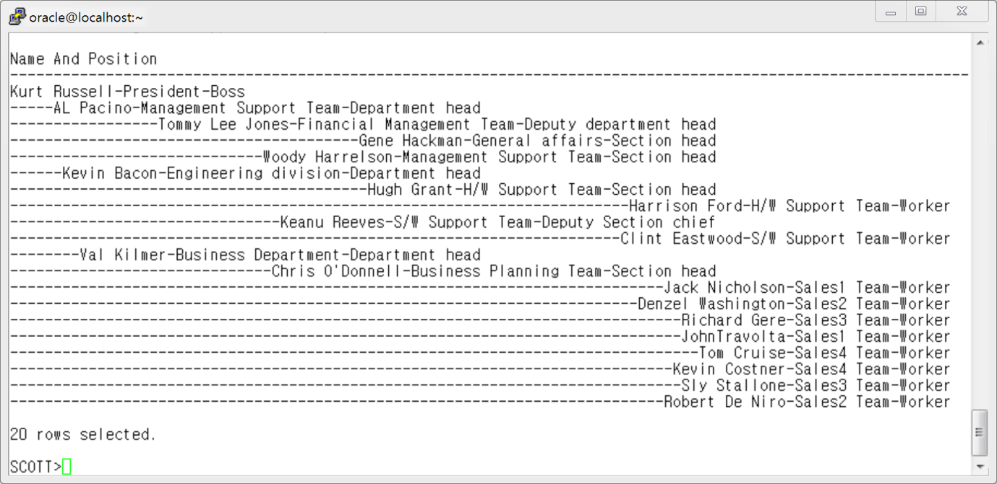
1. emp2 테이블과 dept2 테이블을 사용하여 아래와 같이 사원명과 부서와 직급을 합쳐서 출력하되 부서와 직급별로 계층형 쿼리를 사용하여 출력하세요. 단 직급이 없는 사람들은 직급을 ‘Team-Worker’ 로 출력하세요.
- 출력 결과 화면 : 아래와 같이 출력하세요

Slide 23
col "이름 /부서 /직급" for a90
SELECT e.empno
,LPAD('○',LEVEL*4)||e.name||' /'||d.dname||' /'|| NVL(e.position,'Worker') "이름 /부서 /직급"
FROM emp2 e, (SELECT dname,dcode,pdept FROM dept2) d
WHERE e.deptno = d.dcode
CONNECT BY PRIOR e.empno = e.pempno
START WITH e.empno = 19900101 ;
EMPNO 이름 /부서 /직급
---------- -------------------------------------------------------------------------------
19900101 ○Kurt Russell /President /Boss
19960101 ○AL Pacino /Management Support Team /Department head
19930331 ○Tommy Lee Jones /Financial Management Team /Deputy department head
19950303 ○Gene Hackman /General affairs /Section head
19970201 ○Woody Harrelson /Management Support Team /Section head
19966102 ○Kevin Bacon /Engineering division /Department head
19930402 ○Hugh Grant /H/W Support Team /Section head
20000119 ○Harrison Ford /H/W Support Team /Worker
19960303 ○Keanu Reeves /S/W Support Team /Deputy Section chief
20000210 ○Clint Eastwood /S/W Support Team /Worker
19970112 ○Val Kilmer /Business Department /Department head
19960212 ○Chris O'Donnell /Business Planning Team /Section head
20000101 ○Jack Nicholson /Sales1 Team /Worker
20000102 ○Denzel Washington /Sales2 Team /Worker
20000203 ○Richard Gere /Sales3 Team /Worker
20000305 ○JohnTravolta /Sales1 Team /Worker
20000308 ○Tom Cruise /Sales4 Team /Worker
20000334 ○Kevin Costner /Sales4 Team /Worker
20000407 ○Sly Stallone /Sales3 Team /Worker
20006106 ○Robert De Niro /Sales2 Team /Worker
20 개의 행이 선택되었습니다.

Slide 24
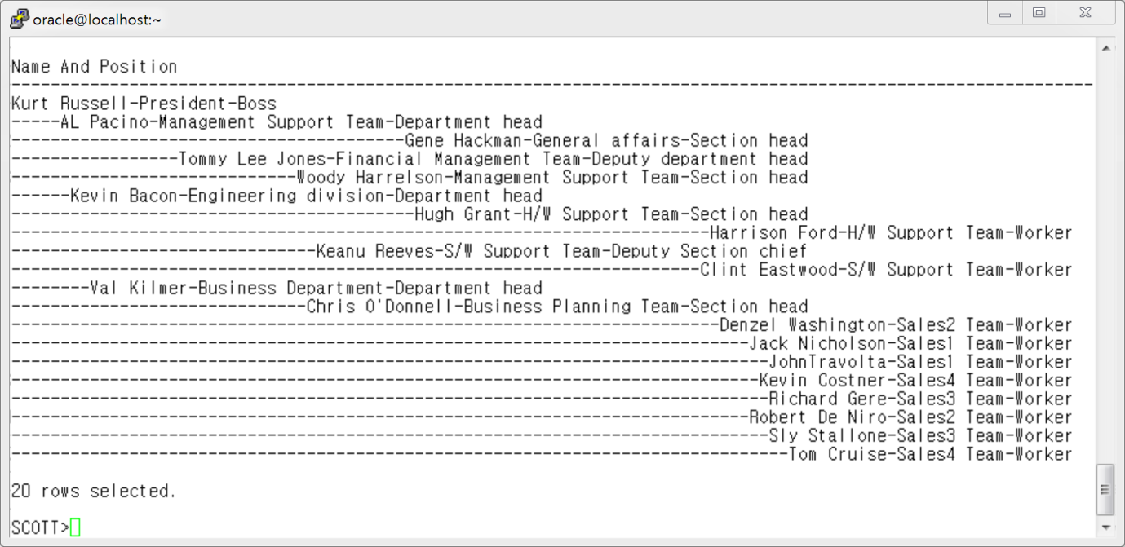
계층 쿼리 내에서 정렬을 해서 출력하려면 마지막 줄에 ORDER SIBLINGS BY e.name ; 절 사용함

Slide 25
col "이름 /부서 /직급" for a90
SELECT e.empno
,LPAD('○',LEVEL*4)||e.name||' /'||d.dname||' /'|| NVL(e.position,'Worker') "이름 /부서 /직급"
FROM emp2 e, (SELECT dname,dcode,pdept FROM dept2) d
WHERE e.deptno = d.dcode
CONNECT BY PRIOR e.empno = e.pempno
START WITH e.empno = 19900101
ORDER SIBLINGS BY e.name ;
EMPNO 이름 /부서 /직급
---------- -------------------------------------------------------------------------------
19900101 ○Kurt Russell /President /Boss
19960101 ○AL Pacino /Management Support Team /Department head
19950303 ○Gene Hackman /General affairs /Section head
19930331 ○Tommy Lee Jones /Financial Management Team /Deputy department head
19970201 ○Woody Harrelson /Management Support Team /Section head
19966102 ○Kevin Bacon /Engineering division /Department head
19930402 ○Hugh Grant /H/W Support Team /Section head
20000119 ○Harrison Ford /H/W Support Team /Worker
19960303 ○Keanu Reeves /S/W Support Team /Deputy Section chief
20000210 ○Clint Eastwood /S/W Support Team /Worker
19970112 ○Val Kilmer /Business Department /Department head
19960212 ○Chris O'Donnell /Business Planning Team /Section head
20000102 ○Denzel Washington /Sales2 Team /Worker
20000101 ○Jack Nicholson /Sales1 Team /Worker
20000305 ○JohnTravolta /Sales1 Team /Worker
20000334 ○Kevin Costner /Sales4 Team /Worker
20000203 ○Richard Gere /Sales3 Team /Worker
20006106 ○Robert De Niro /Sales2 Team /Worker
20000407 ○Sly Stallone /Sales3 Team /Worker
20000308 ○Tom Cruise /Sales4 Team /Worker
20 개의 행이 선택되었습니다.

Slide 26
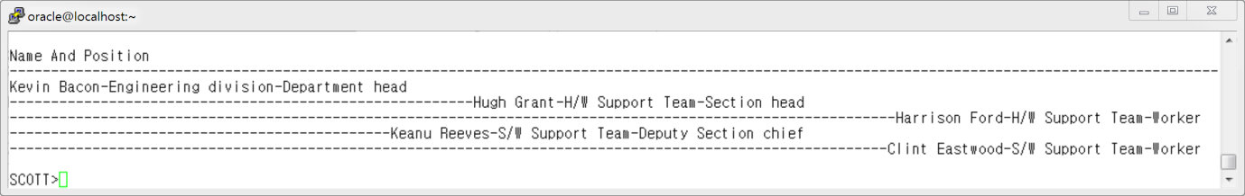
2. emp2 테이블에서 "Kevin Bacon-Engineering division-Department head" 아래에 속한 부하직원만 계층쿼리로 조회해서 출력하세요.
(단, 직급이 없는 사람은 'Team-Worker' 로 표시하세요)

Slide 27
col "이름 /부서 /직급" for a90
SELECT e.empno
,LPAD('○',LEVEL*4) || e.name||' /'||d.dname||' /'|| NVL(e.position,'Worker') "이름 /부서 /직급"
FROM emp2 e, (SELECT dname,dcode,pdept FROM dept2) d
WHERE e.deptno = d.dcode
CONNECT BY PRIOR e.empno = e.pempno
START WITH e.empno = 19966102;
EMPNO 이름 /부서 /직급
---------- ----------------------------------------------------------------------
19966102 ○Kevin Bacon /Engineering division /Department head
19930402 ○Hugh Grant /H/W Support Team /Section head
20000119 ○Harrison Ford /H/W Support Team /Worker
19960303 ○Keanu Reeves /S/W Support Team /Deputy Section chief
20000210 ○Clint Eastwood /S/W Support Team /Worker
EMPNO 이름 /부서 /직급
---------- -------------------------------------------------------------------------------
19900101 ○Kurt Russell /President /Boss
19960101 ○AL Pacino /Management Support Team /Department head
19950303 ○Gene Hackman /General affairs /Section head
19930331 ○Tommy Lee Jones /Financial Management Team /Deputy department head
19970201 ○Woody Harrelson /Management Support Team /Section head
19966102 ○Kevin Bacon /Engineering division /Department head
19930402 ○Hugh Grant /H/W Support Team /Section head
20000119 ○Harrison Ford /H/W Support Team /Worker
19960303 ○Keanu Reeves /S/W Support Team /Deputy Section chief
20000210 ○Clint Eastwood /S/W Support Team /Worker
19970112 ○Val Kilmer /Business Department /Department head
19960212 ○Chris O'Donnell /Business Planning Team /Section head
20000102 ○Denzel Washington /Sales2 Team /Worker
20000101 ○Jack Nicholson /Sales1 Team /Worker
20000305 ○JohnTravolta /Sales1 Team /Worker
20000334 ○Kevin Costner /Sales4 Team /Worker
20000203 ○Richard Gere /Sales3 Team /Worker
20006106 ○Robert De Niro /Sales2 Team /Worker
20000407 ○Sly Stallone /Sales3 Team /Worker
20000308 ○Tom Cruise /Sales4 Team /Worker
20 개의 행이 선택되었습니다.

Slide 28
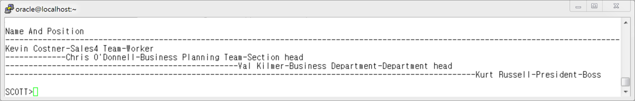
3: emp2테이블에서 "Kevin Costner" 사원의 상사들을 계층 쿼리로 아래 화면과 같이 출력하세요.

Slide 29
col "이름 /부서 /직급" for a90
SELECT e.empno
,LPAD('○',LEVEL*4) || e.name||' /'||d.dname||' /'|| NVL(e.position,'Worker') "이름 /부서 /직급"
FROM emp2 e, (SELECT dname,dcode,pdept FROM dept2) d
WHERE e.deptno = d.dcode
CONNECT BY e.empno = PRIOR e.pempno
START WITH e.empno = 20000334;
EMPNO 이름 /부서 /직급
---------- ------------------------------------------------------------------------
20000334 ○Kevin Costner /Sales4 Team /Worker
19960212 ○Chris O'Donnell /Business Planning Team /Section head
19970112 ○Val Kilmer /Business Department /Department head
19900101 ○Kurt Russell /President /Boss
EMPNO 이름 /부서 /직급
---------- -------------------------------------------------------------------------------
19900101 ○Kurt Russell /President /Boss
19960101 ○AL Pacino /Management Support Team /Department head
19950303 ○Gene Hackman /General affairs /Section head
19930331 ○Tommy Lee Jones /Financial Management Team /Deputy department head
19970201 ○Woody Harrelson /Management Support Team /Section head
19966102 ○Kevin Bacon /Engineering division /Department head
19930402 ○Hugh Grant /H/W Support Team /Section head
20000119 ○Harrison Ford /H/W Support Team /Worker
19960303 ○Keanu Reeves /S/W Support Team /Deputy Section chief
20000210 ○Clint Eastwood /S/W Support Team /Worker
19970112 ○Val Kilmer /Business Department /Department head
19960212 ○Chris O'Donnell /Business Planning Team /Section head
20000102 ○Denzel Washington /Sales2 Team /Worker
20000101 ○Jack Nicholson /Sales1 Team /Worker
20000305 ○JohnTravolta /Sales1 Team /Worker
20000334 ○Kevin Costner /Sales4 Team /Worker
20000203 ○Richard Gere /Sales3 Team /Worker
20006106 ○Robert De Niro /Sales2 Team /Worker
20000407 ○Sly Stallone /Sales3 Team /Worker
20000308 ○Tom Cruise /Sales4 Team /Worker
20 개의 행이 선택되었습니다.

Slide 30
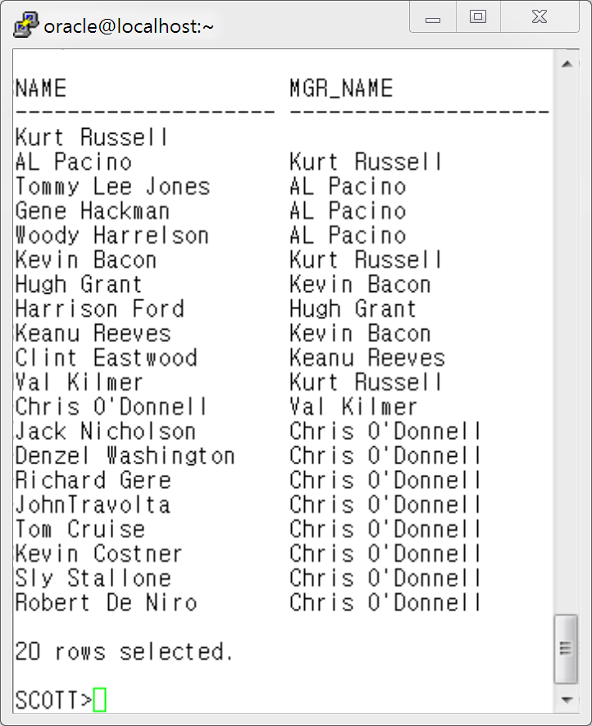
4.아래와 같이 사원의 이름과 상사의 이름이 함께 나오도록 계층형 쿼리를 작성하세요.
(아래 예제는 join 같은 방법으로 작성할 수 있으나 여기서는 계층형 쿼리로 연습합니다)
desc emp2
이름 널? 유형
-------------------- -------- -------------
EMPNO NOT NULL NUMBER
NAME NOT NULL VARCHAR2(30)
BIRTHDAY DATE
DEPTNO NOT NULL VARCHAR2(6)
EMP_TYPE VARCHAR2(30)
TEL VARCHAR2(15)
HOBBY VARCHAR2(30)
PAY NUMBER
POSITION VARCHAR2(30)
PEMPNO NUMBER

Slide 31
SELECT name "NAME" , PRIOR name "MGR_NAME"
FROM emp2
START WITH pempno IS NULL
CONNECT BY PRIOR empno=pempno ;
col "이름" for a40
SELECT e.empno
,LPAD('○',LEVEL*4)||e.name "이름"
,pempno
FROM emp2 e
CONNECT BY PRIOR e.empno = e.pempno
START WITH e.empno = 19900101
ORDER SIBLINGS BY e.name ;
NAME MGR_NAME
-------------------- -------------
Kurt Russell
AL Pacino Kurt Russell
Tommy Lee Jones AL Pacino
Gene Hackman AL Pacino
Woody Harrelson AL Pacino
Kevin Bacon Kurt Russell
Hugh Grant Kevin Bacon
Harrison Ford Hugh Grant
Keanu Reeves Kevin Bacon
Clint Eastwood Keanu Reeves
Val Kilmer Kurt Russell
Chris O'Donnell Val Kilmer
Jack Nicholson Chris O'Donnell
Denzel Washington Chris O'Donnell
Richard Gere Chris O'Donnell
JohnTravolta Chris O'Donnell
Tom Cruise Chris O'Donnell
Kevin Costner Chris O'Donnell
Sly Stallone Chris O'Donnell
Robert De Niro Chris O'Donnell
20 개의 행이 선택되었습니다.
EMPNO 이름 PEMPNO
---------- ---------------------------------------- ----------
19900101 ○Kurt Russell
19960101 ○AL Pacino 19900101
19950303 ○Gene Hackman 19960101
19930331 ○Tommy Lee Jones 19960101
19970201 ○Woody Harrelson 19960101
19966102 ○Kevin Bacon 19900101
19930402 ○Hugh Grant 19966102
20000119 ○Harrison Ford 19930402
19960303 ○Keanu Reeves 19966102
20000210 ○Clint Eastwood 19960303
19970112 ○Val Kilmer 19900101
19960212 ○Chris O'Donnell 19970112
20000102 ○Denzel Washington 19960212
20000101 ○Jack Nicholson 19960212
20000305 ○JohnTravolta 19960212
20000334 ○Kevin Costner 19960212
20000203 ○Richard Gere 19960212
20006106 ○Robert De Niro 19960212
20000407 ○Sly Stallone 19960212
20000308 ○Tom Cruise 19960212
20 개의 행이 선택되었습니다.

Slide 32
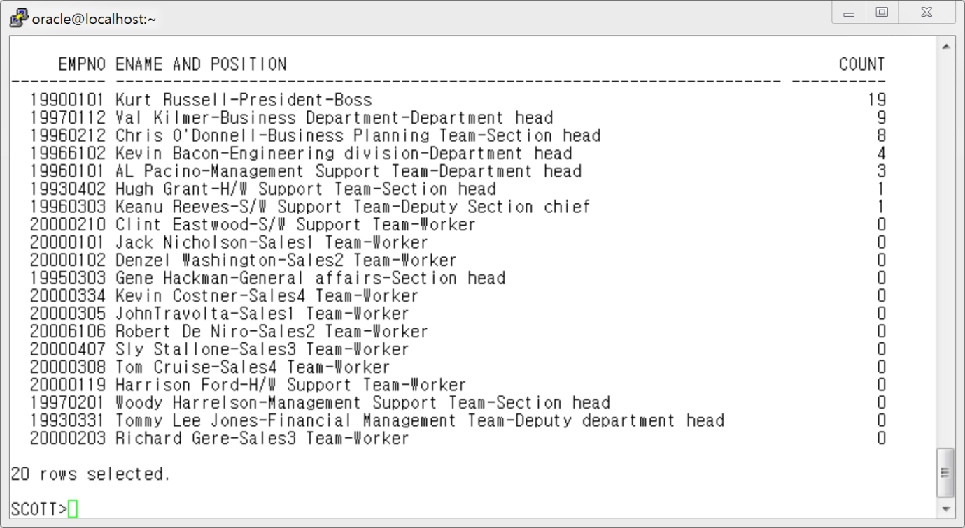
5.아래와 같이 emp2 테이블과 dept2 테이블을 조회하여
사번과 사원명-부서-직급 ,부하직원 수를 출력하세요.

Slide 33
COL "이름/부서명/직급" FOR a70
SELECT empno , name||' /'||d.dname||' /'||NVL(a.position,'Worker') "이름/부서명/직급",
(SELECT COUNT(*)
FROM emp2
START WITH empno = a.empno
CONNECT BY PRIOR empno = pempno) -1 "부하직원수"
FROM emp2 a , (SELECT dname , dcode FROM dept2 ) d
WHERE a.deptno = d.dcode
ORDER BY 3 DESC ;
EMPNO 이름/부서명/직급 부하직원수
---------- ---------------------------------------------------------------------- ----------
19900101 Kurt Russell /President /Boss 19
19970112 Val Kilmer /Business Department /Department head 9
19960212 Chris O'Donnell /Business Planning Team /Section head 8
19966102 Kevin Bacon /Engineering division /Department head 4
19960101 AL Pacino /Management Support Team /Department head 3
19960303 Keanu Reeves /S/W Support Team /Deputy Section chief 1
19930402 Hugh Grant /H/W Support Team /Section head 1
20000119 Harrison Ford /H/W Support Team /Worker 0
20000210 Clint Eastwood /S/W Support Team /Worker 0
20000334 Kevin Costner /Sales4 Team /Worker 0
19930331 Tommy Lee Jones /Financial Management Team /Deputy department head 0
19970201 Woody Harrelson /Management Support Team /Section head 0
20000101 Jack Nicholson /Sales1 Team /Worker 0
19950303 Gene Hackman /General affairs /Section head 0
20000102 Denzel Washington /Sales2 Team /Worker 0
20006106 Robert De Niro /Sales2 Team /Worker 0
20000407 Sly Stallone /Sales3 Team /Worker 0
20000203 Richard Gere /Sales3 Team /Worker 0
20000308 Tom Cruise /Sales4 Team /Worker 0
20000305 JohnTravolta /Sales1 Team /Worker 0
20 개의 행이 선택되었습니다.

Slide 34
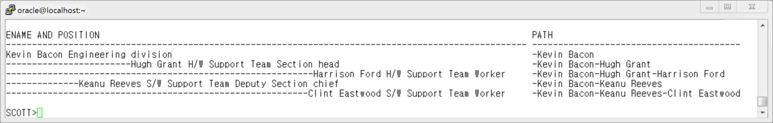
6. 아래 예시화면과 같이 "Kevin Bacon" 직원의 부하 직원들의 명단을 출력하되 전체 경로까지 함께 나오도록 출력하세요..
EMPNO 이름 PEMPNO
---------- ---------------------------------------- ----------
19900101 ○Kurt Russell
19960101 ○AL Pacino 19900101
19950303 ○Gene Hackman 19960101
19930331 ○Tommy Lee Jones 19960101
19970201 ○Woody Harrelson 19960101
19966102 ○Kevin Bacon 19900101
19930402 ○Hugh Grant 19966102
20000119 ○Harrison Ford 19930402
19960303 ○Keanu Reeves 19966102
20000210 ○Clint Eastwood 19960303
19970112 ○Val Kilmer 19900101
19960212 ○Chris O'Donnell 19970112
20000102 ○Denzel Washington 19960212
20000101 ○Jack Nicholson 19960212
20000305 ○JohnTravolta 19960212
20000334 ○Kevin Costner 19960212
20000203 ○Richard Gere 19960212
20006106 ○Robert De Niro 19960212
20000407 ○Sly Stallone 19960212
20000308 ○Tom Cruise 19960212
20 개의 행이 선택되었습니다.
col "이름" for a40
SELECT e.empno
,LPAD('○',LEVEL*4)||e.name "이름"
,pempno
FROM emp2 e
CONNECT BY PRIOR e.empno = e.pempno
START WITH e.empno = 19900101
ORDER SIBLINGS BY e.name ;

Slide 35
COL "이름/부서명/직급" FOR a60
COL "PATH" FOR a45
SELECT LPAD('▶',LEVEL*4)||e.name||'*'||d.dname||'*'||NVL(e.position,'Worker') "이름/부서명/직급"
,SYS_CONNECT_BY_PATH(e.name,'-') "PATH"
FROM emp2 e, (SELECT dname,dcode,pdept FROM dept2) d
WHERE e.deptno = d.dcode
CONNECT BY PRIOR e.empno = e.pempno
START WITH e.empno = 19966102 ;
이름/부서명/직급 PATH
------------------------------------------------------------ ---------------------------------------------
▶Kevin Bacon*Engineering division*Department head -Kevin Bacon
▶Hugh Grant*H/W Support Team*Section head -Kevin Bacon-Hugh Grant
▶Harrison Ford*H/W Support Team*Worker -Kevin Bacon-Hugh Grant-Harrison Ford
▶Keanu Reeves*S/W Support Team*Deputy Section chief -Kevin Bacon-Keanu Reeves
▶Clint Eastwood*S/W Support Team*Worker -Kevin Bacon-Keanu Reeves-Clint Eastwood

Slide 36
수고했습니다.

